Slide 1
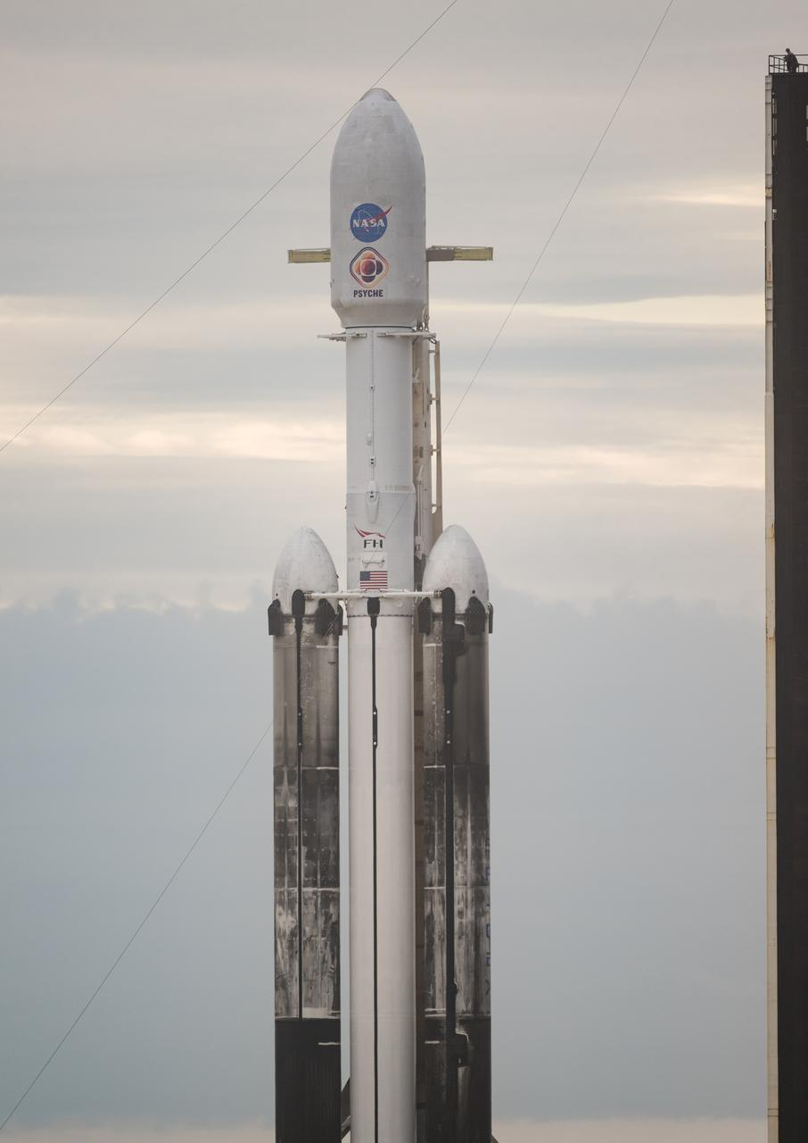
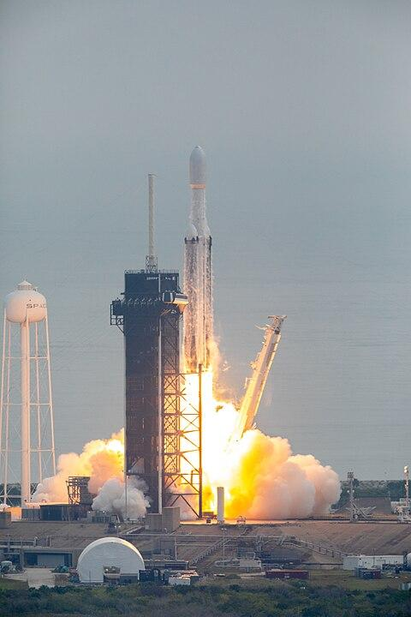
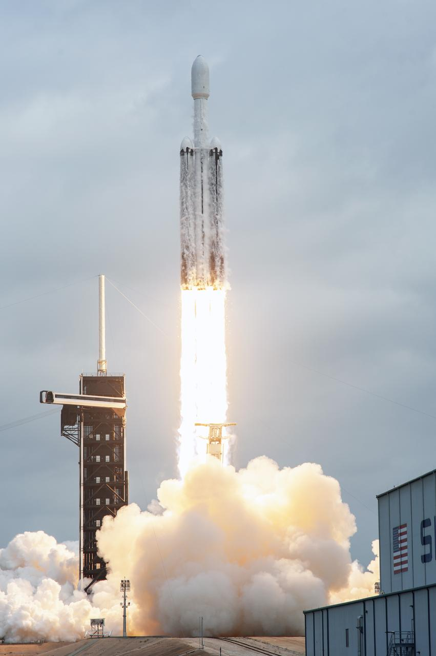
The NASA mission to 16 Psyche Asteroid
Presentation v2.0 by Shawn Jipp.
My thanks to NASA, ChatGPT 3.5, Wikipedia, and Professor Lindy Elkins-Tanton.

Slide 2
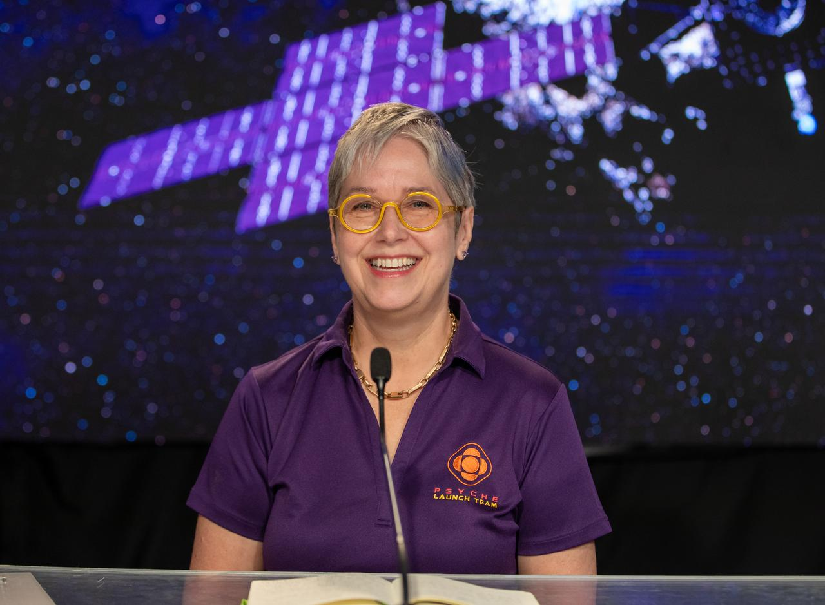
Principal Investigator - Psyche Mission Leader
The mission's leader – Principal Investigator Lindy Elkins-Tanton – She is based at Arizona State University (ASU) in Tempe.

Slide 3

The Psyche Patch

Slide 4
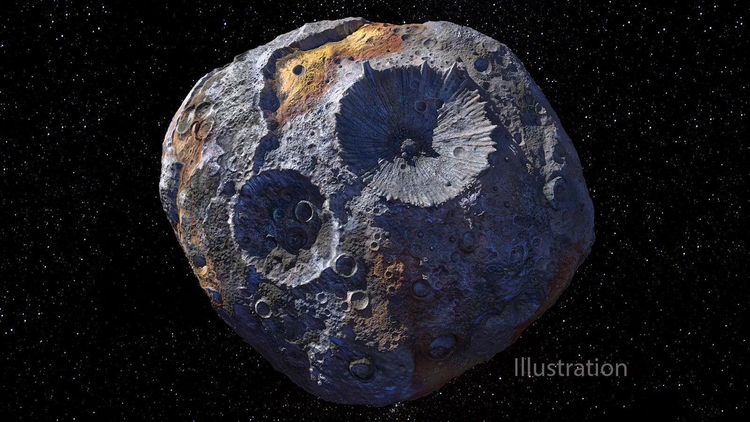
Psyche

Slide 5
Psyche Facts
“Psyche” is the Greek-Roman goddess of the soul, often depicted as a butterfly-winged female figure. We get the word psyche from it. Here is the definition of that word: "In psychology, the psyche is the totality of the human mind, conscious and unconscious. Psychology is the scientific or objective study of the psyche." Wikipedia
The asteroid 16 Psyche was discovered in 1852 by Italian astronomer Annibale de Gasparis at the Naples Observatory. He named it Psyche and since it was the 16th asteroid to be discovered, 16 Psyche.
16 Psyche is the heaviest and largest known M-type asteroid (metal type) of the 9 metal asteroids we have discovered, and may be an exposed iron core of a protoplanet (Vesta is a protoplanet), the remnant of a violent collision with another object that stripped off its mantle and crust. Psyche contains about one percent of the entire mass of the asteroid belt which consists of ~1.5 million asteroids.
Psyche rotates once every 4.2 hours vertically, not horizontally.
Radar observations of the asteroid from Earth indicate an iron–nickel composition.
Psyche composition could be:
  A mixed metal and silicate world
  A metal core of a protoplanet
  A differentiated world with a regolith composition, peppered with localized regions of high metal concentrations
  A world where the sun has possibly changed the iron into a different metal

Slide 6
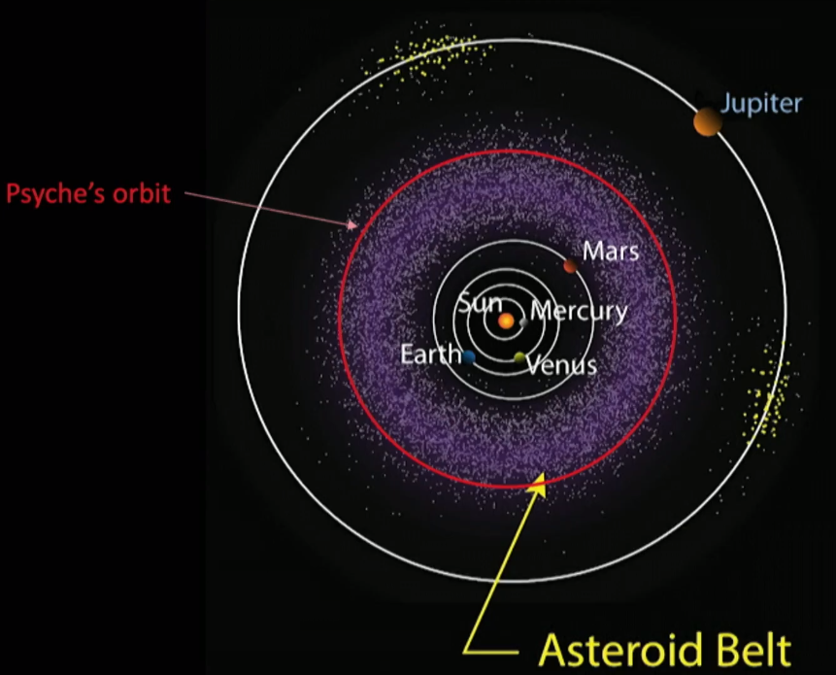
Where is Psyche?

Slide 7
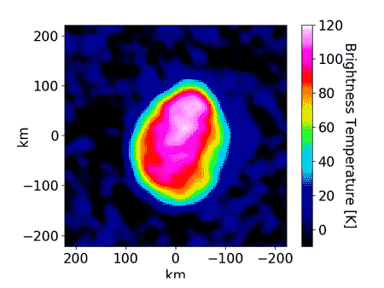
Temperature of Psyche
De Kleer and Cambioni, together with co-author Michael Shepard of Bloomsburg University in Pennsylvania, took advantage of the Atacama Large Millimeter/submillimeter Array (ALMA) in Chile, which became fully operational in 2013, to obtain such data. The array of 66 radio telescopes enabled the team to map the thermal emissions from Psyche's entire surface at a resolution of 30 km (where each pixel is 30 km by 30 km) and generate an image of the asteroid composed of about 50 pixels.
This was possible because ALMA observed Psyche at millimeter wavelengths, which are longer (ranging from 1 to 10 mm) than the infrared wavelengths (typically between 5 and 30 µm). The use of longer wavelengths allowed the researchers to combine the data collected from the 66 telescopes to create a much larger effective telescope; the larger a telescope, the higher the resolution of the images it produces.

Slide 8
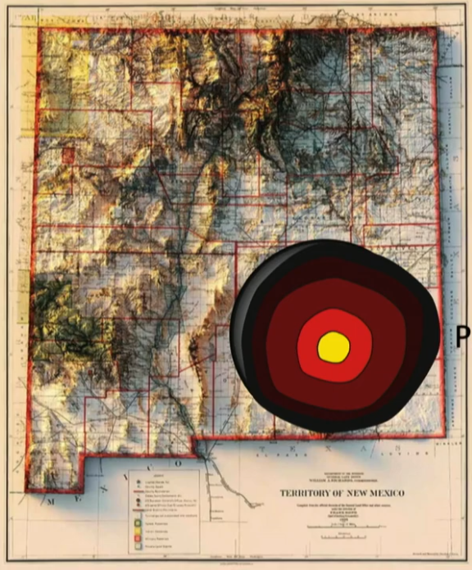
Shape and Size of 16 Psyche
The most recent models show that Psyche has a shape consistent with a Jacobi ellipsoid and dimensions within a few km of 278 km (173 mi) x 238 km (148 mi) x 171 km (106 mi).
Professor Lindy says she is going with Psyche looking like a potato since that encompasses various shapes!
We live(d) here!

Slide 9

The Psyche Mission

Slide 10
The Psyche Spacecraft Mission
The NASA Psyche mission is a robotic space mission launched by NASA to explore a unique metallic asteroid named 16 Psyche which is located in the farthest part of the asteroid belt between Mars and Jupiter. The distance to travel to Psyche is About 2.2 billion miles (3.6 billion kilometers) and will take about 5.8 years. The spacecraft will get a gravitational boost by passing closely by Mars in 2026.
16 Psyche is of particular interest because it is believed to be mostly composed of metal, primarily iron and nickel, making it distinct from the more common rocky or carbon-rich asteroids.
The primary scientific objectives of the Psyche mission are to:
Determine the asteroid's composition, including its elemental and mineralogical makeup.
Study the asteroid's interior structure and investigate whether it has a metallic core.
Explore the asteroid's history and formation processes, shedding light on the early solar system.
Understand the early building blocks of planetary bodies and the potential role of metallic asteroids in the formation of planets.

Slide 11
Psyche Spacecraft FAQS
The Psyche mission is a collaborative effort involving multiple institutions and organizations, including NASA's JPL, Arizona State University, and other research institutions. The Psyche spacecraft was built by NASA's Jet Propulsion Laboratory (JPL) in Pasadena, California.
Mission approved January 4, 2017
Mission cost expected to be ~ 1.2 billion dollars
SpaceX was paid 131 million for the launch
The Psyche spacecraft was launched atop a SpaceX Falcon Heavy rocket from Kennedy Space Center Pad 39A in Florida at 10:19 AM EDT on Friday, the 13th of October, 2023.
This is the first time the SpaceX Falcon Heavy rocket was used for a NASA mission. Both side boosters have been successfully flown 3X before. NASA has approved of this reusability. Both side boosters landed successfully back at Kennedy Space Center. The center booster was expendable.

Slide 12
Scientific Instruments Aboard
Psyche’s magnetometers (2) will look for evidence of an ancient magnetic field at the asteroid Psyche. A residual magnetic field would be strong evidence the asteroid formed from the core of a planetary body.
The orbiter’s gamma-ray (1) and (3) neutron spectrometers will help scientists determine the chemical elements that make up the asteroid. Figuring out what Psyche is composed of will enable scientists to better understand how it formed. Gamma rays passing through the solar system will reflect off of the asteroid and then hit the gamma-ray spectrometer which contains a large super pure Germanium crystal. We will then be able through computer modeling to see what the asteroid's material composition consists of!
The spacecraft’s multispectral imagers (2) will provide information about the mineral composition of Psyche as well as its topography.
The Psyche science team will harness the telecommunications system, used to send commands to and receive data from the spacecraft, to conduct gravity science also. By analyzing the radio waves the spacecraft communicates with, scientists can measure how the asteroid Psyche affects the spacecraft’s orbit. From that information, scientists can determine the asteroid’s rotation, mass, and gravity field, gaining additional insights into the composition and structure of the asteroid’s interior.

Slide 13
Science Goals and Purpose of the Mission
Specifically, the science goals for the mission are:
Understand a previously unexplored building block of planet formation: iron cores.
Look inside terrestrial planets, including Earth, by directly examining the interior of a differentiated body, which otherwise could not be seen.
Explore a new type of world, made of metal.
The science questions this mission aims to address are:
Is 16 Psyche the stripped core of a differentiated planetesimal, or was it formed as an iron-rich body? What were the building blocks of planets? Did planetesimals that formed close to the Sun have very different bulk compositions?
If 16 Psyche was stripped of its mantle, when and how did that occur?
If 16 Psyche was once molten, did it solidify from the inside out, or the outside in?
Did 16 Psyche produce a magnetic dynamo as it cooled?
What are the major alloy elements that coexist in the iron metal of the core?
What are the key characteristics of the geologic surface and global topography? Does 16 Psyche look radically different from known stony and icy bodies?
How do craters on a metal body differ from those in rock or ice?

Slide 14
Who Built the Basic Psyche Spacecraft?
Maxar Technologies of Westminster, Colorado. Maxar’s major competitors are Boeing Satellite Systems, Lockheed Martin, Thales Alenia Space, Airbus Defence and Space and JSC Information Satellite Systems.
Here is the Maxar ancestry:
1892: Founded as Helios Electric Company (the company manufactured carbon-arc lamps.)
1906: Philadelphia Storage Battery Company (began making batteries for electric vehicles.)
1919: Philco (rectifier units, radios, record players, car radios, air conditioners, refrigerators, home freezers, consumer televisions, electric ranges, home laundry washers and dryers, televisions, portable phonographs, portable TVs, commercial computers, flight computers for Navy jets.)
1960: Western Development Labs division of Philco builds first repeater communications satellites.
  1961: Ford buys Philco. Soon after Ford drops computer line from Philco.
  1966: Philco products become Philco-Ford Products.
    1973: Ford sells Philco to GTE-Sylvania.
      1977: GTE-Sylvania sells Philco to White Consolidated Industries.
        1981: White Consolidated Industries sells Philco (and Sylvania name) to Philips
  1990: Loral buys the Aeronutronic/Ford Aerospace division from Ford for $715 million.
    2012: Space Systems/Loral was acquired by the Canadian aerospace company MacDonald Dettwiler for $875 million.
      2017: MacDonald Dettwiler merged with DigitalGlobe and was renamed as Maxar Technologies. SSL, formerly Space Systems/Loral, of Palo Alto, California, is a wholly owned manufacturing subsidiary of Maxar Technologies.
        2023: Maxar Technologies announced that U.S. private equity firm Advent International, alongside minority investor British Columbia Investment Management Corporation, completed their acquisition of Maxar. With the closing of the transaction, Maxar remained as an U.S.-controlled, owned and operated company.

Slide 15
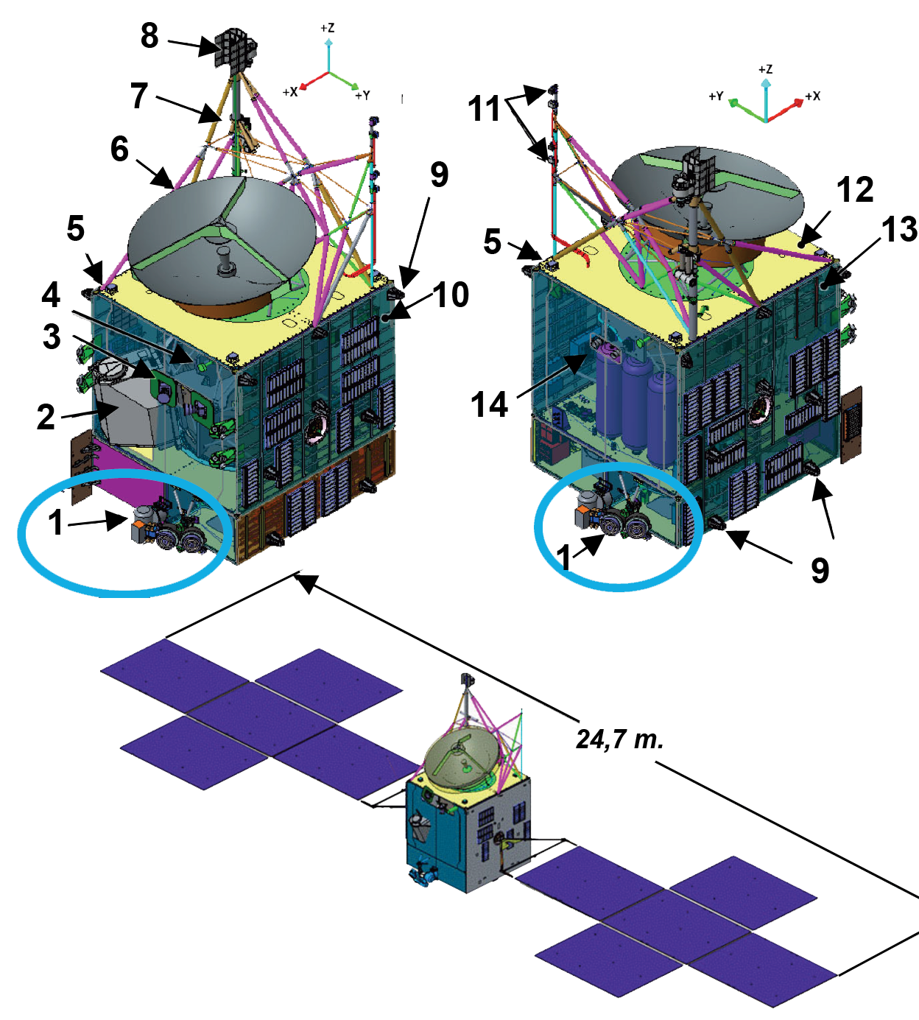
Psyche Spacecraft Components Fig 1
Instruments onboard of the spacecraft: 1. Hall-effect thrusters 2. Optical telecommunications system 3. Star trackers 4. Low-gain antenna 5. Sun sensor 6. X-band High-gain antenna 7. Neutron spectrometer 8. Gamma-ray spectrometer 9. Cold gas thrusters 10. -Y Panel 11. Magnetometer 12. Top deck 13. +Y Panel 14. Multispectral imagers (x2)

Slide 16
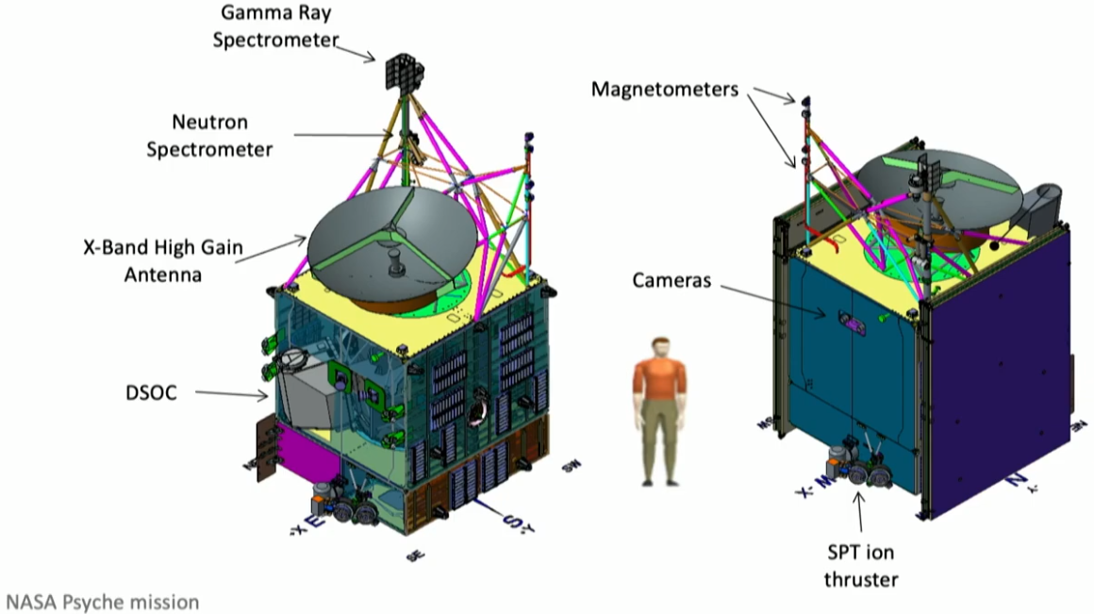
Psyche Spacecraft Components Fig 2

Slide 17
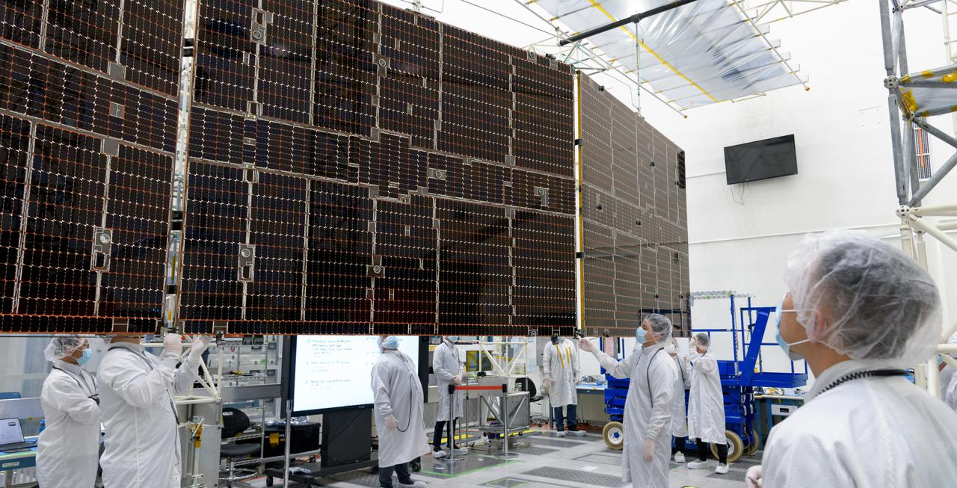
Solar Cells
Electricity is provided by 10 high efficiency, large solar arrays which power everything on board, including the science instruments. In space, at the Earth's distance from the sun, they will generate 21,000 watts. But at a distance from the sun of 16 Psyche, they will only generate between 2,300 and 3,400 watts, which is still sufficient.

Slide 18
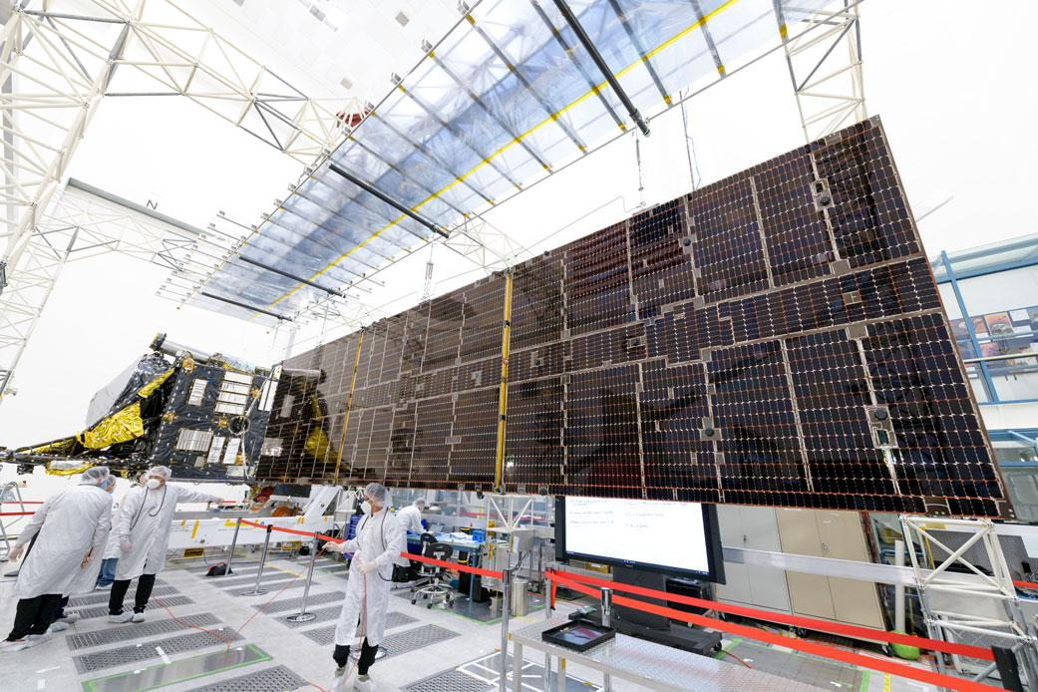
Solar Cells

Slide 19
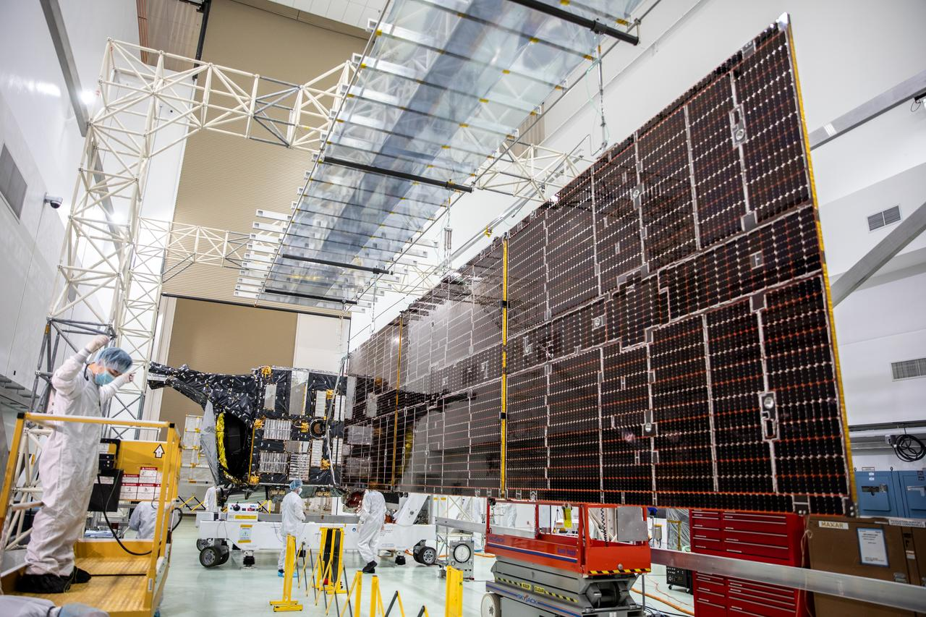
Solar Cells

Slide 20
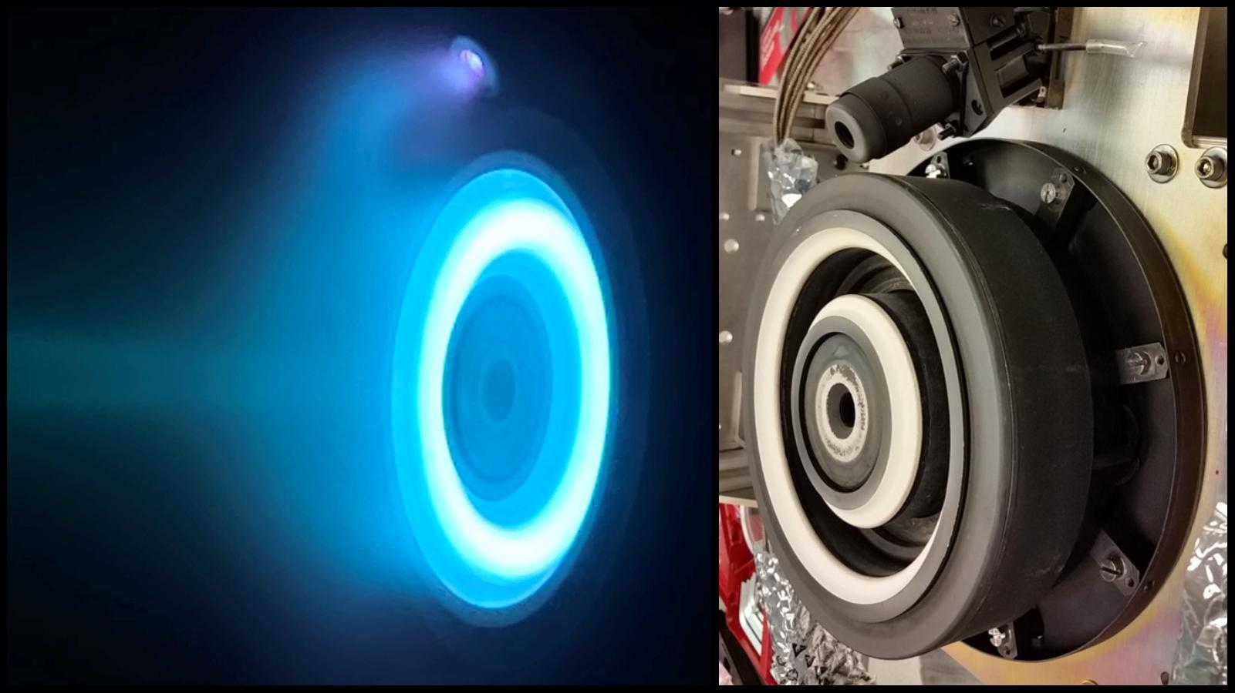
Electric Propulsion (but not by Tesla!)
Psyche uses solar electric propulsion. The system uses Xenon gas as the propellant. The spacecraft has four Hall-effect thrusters that rely on electromagnetic fields to expel charged atoms, or ions, of inert xenon gas that in turn create thrust, trailing a blue glow of xenon. Only one thruster is on at a time, providing up to 240 millinewtons of thrust – about the amount of force that one AA battery would exert on the palm of your hand. Psyche will carry seven ~22-gallon (82-liter) tanks of xenon propellant – which weigh ~2,392 pounds (1,085 kilograms).

Slide 21
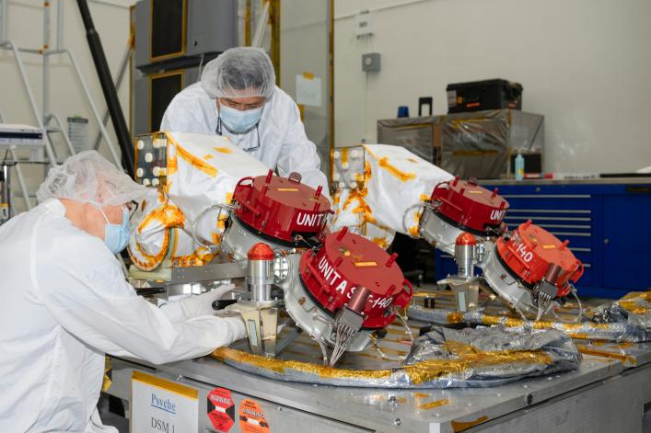
The Four Hall Thrusters

Slide 22
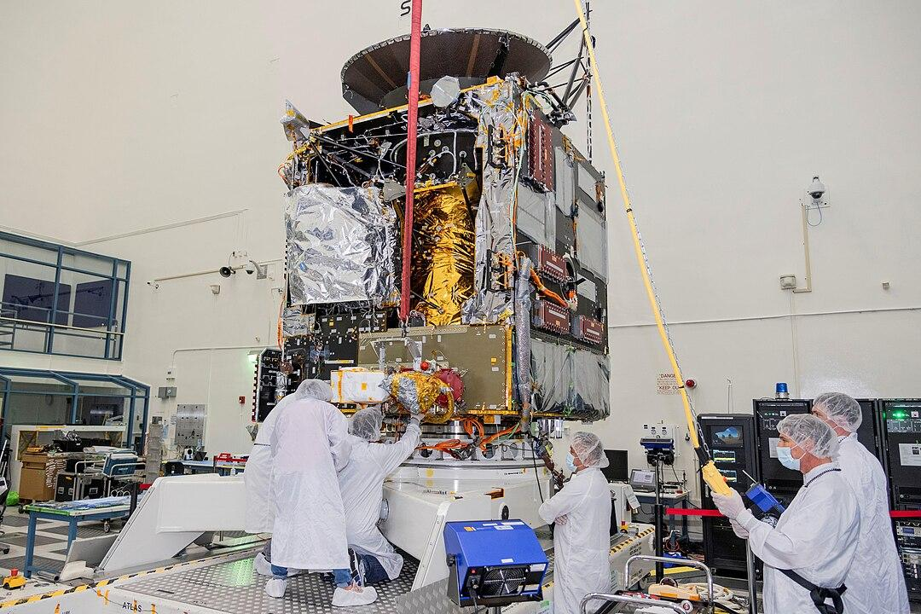
Integrating the Hall Thrusters
The thruster is nominally rated at 4.5 kW operating power, but it will also operate for long durations at about 900 watts. Psyche is the first interplanetary mission to use Hall-effect thrusters, although not the first to use electric thrusters in general.
Thrust=280 mN
Thruster mass=8.5 kg
Propellant mass=922 kg of xenon
Total impulse=8.2 MN·s (for Psyche)

Slide 23
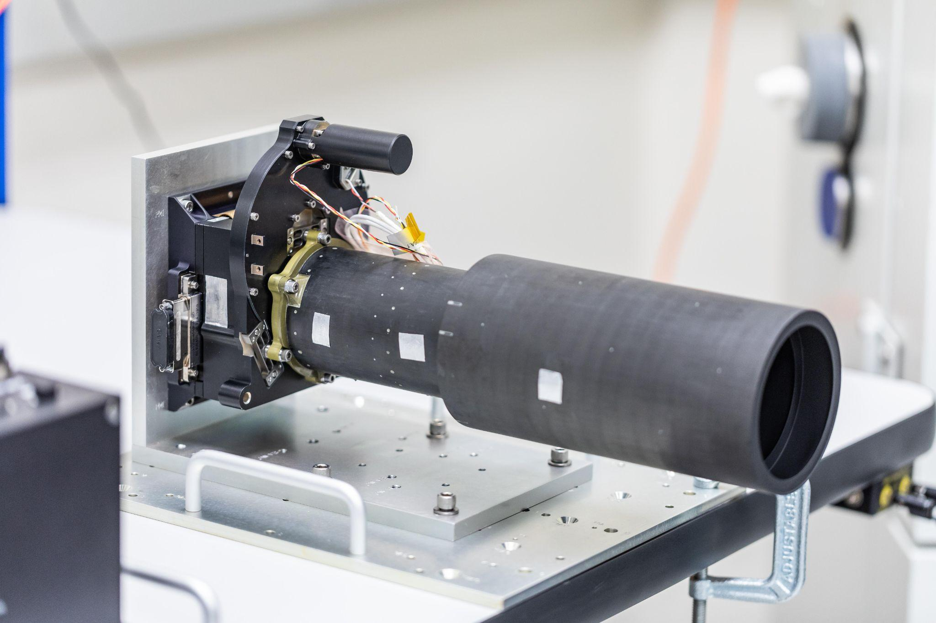
The Imagers (2 are better than just 1!)
Psyche uses same imager as is used in the Curiosity Rover Mastcam and also on the OSIRIS-REx Touch And Go Camera System (TAGCAMS)
The Multispectral Imager (CCD camera) provides high-resolution images using filters to discriminate between Psyche’s metallic and silicate constituents. The instrument consists of a pair of identical cameras designed to acquire geologic, compositional, and topographic data. The purpose of the second camera is to provide redundancy for mission-critical optical navigation. Photo Credit: NASA/JPL-Caltech/ASU/MSSS

Slide 24
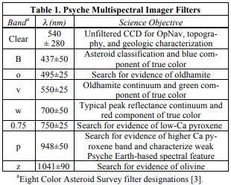
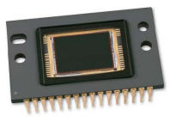
The Imager Details and Imager Filters
Each camera is composed of a telescope (148 mm focal length, f/2.9 focal ratio), camera head (9-position filter wheel, and Focal Plane Array) and a Digital Electronics Assembly mounted separately on the spacecraft.
CCD Camera Specs:
Electronic shutter
Fixed focus 800m to ∞
Focal length=148mm
1600 x 1200 resolution
f/ratio=2.9
Aspect ratio=4:3
SNR >50
Pixel size=7.4 Microns
Capacity of flash drive prior to downlink=4,000 uncompressed images
Kodak Designed
2MP KAI-2020
CCD chip mfg by onsemi semiconductor

Slide 25
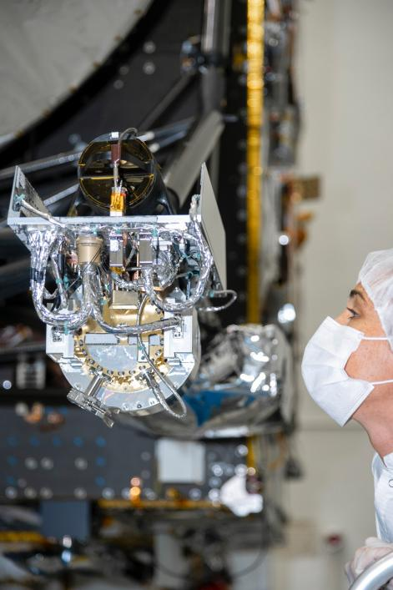
The GRNS (Gamma Ray Neutron Spectrometer)
The spacecraft will use the GRNS to study the neutrons and gamma rays coming from the asteroid's surface to help determine its elemental composition.
As cosmic rays and high energy particles impact the surface of Psyche, the elements that make up the surface material absorb the energy and in response emit neutrons and gamma rays of varying energy levels. These emitted neutrons and gamma rays can be detected by the GRNS and analyzed by scientists, who can match their properties to those emitted by known elements to determine what Psyche is made of.

Slide 26
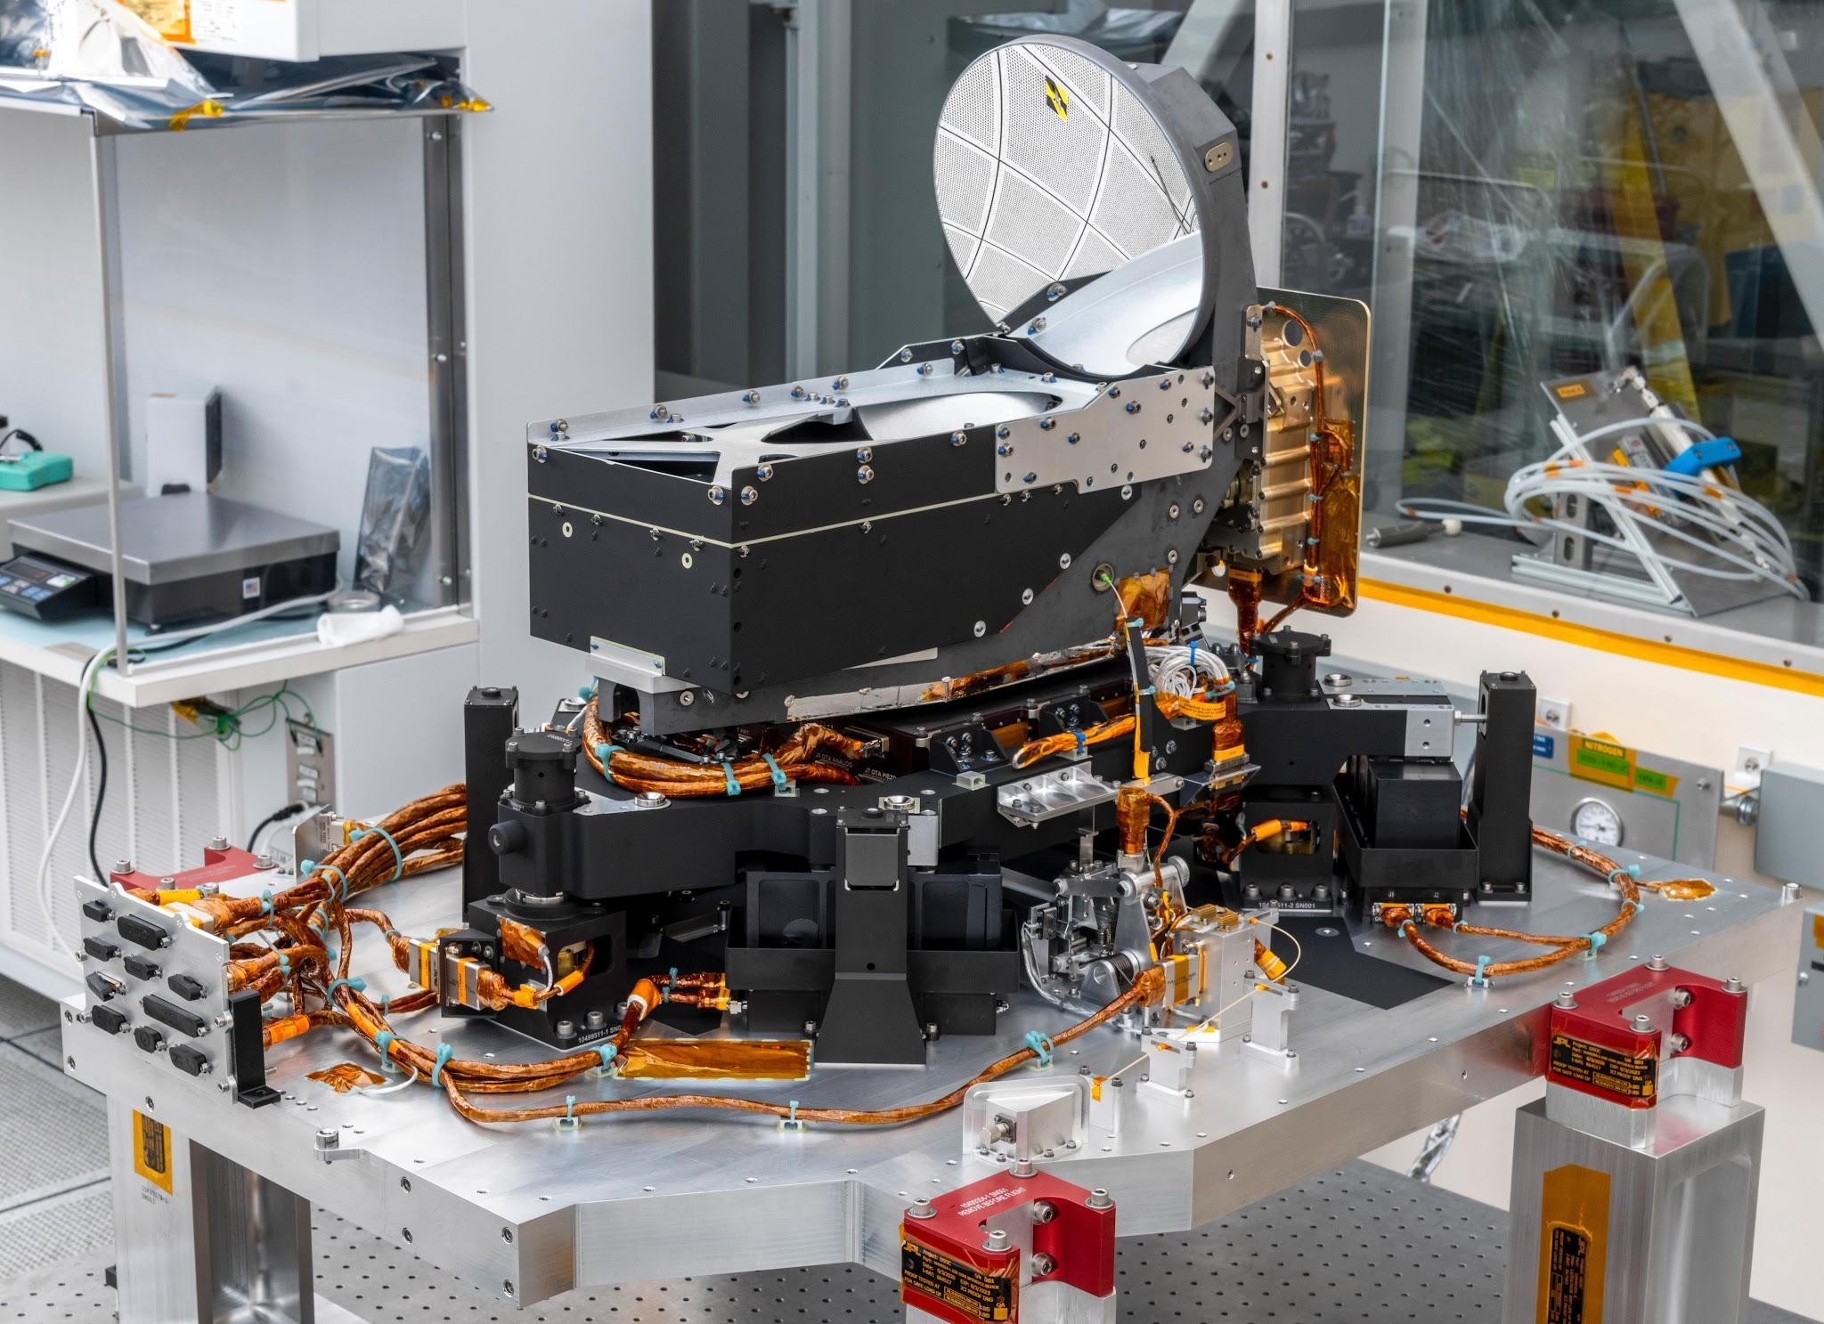
Deep Space Optical Communication (DSOC)
Attached to a side of the Psyche spacecraft is a pioneering technology demonstration: NASA’s Deep Space Optical Communications (DSOC) experiment. Using a near-infrared laser, DSOC will be the agency’s first test of high-bandwidth optical communications between Earth and distances far exceeding the Moon.
DSOC is not intended to relay Psyche mission data since the technology demonstration is planned for the first two years of the spacecraft’s cruise. But if it proves successful, the technology will be used by future human and robotic spacecraft to transmit huge volumes of science data, allowing more innovative space mission concepts to take flight. Ultimately, DSOC may pave the way for broadband communications that will help support humanity’s next giant leap: when NASA sends astronauts to Mars.

Slide 27
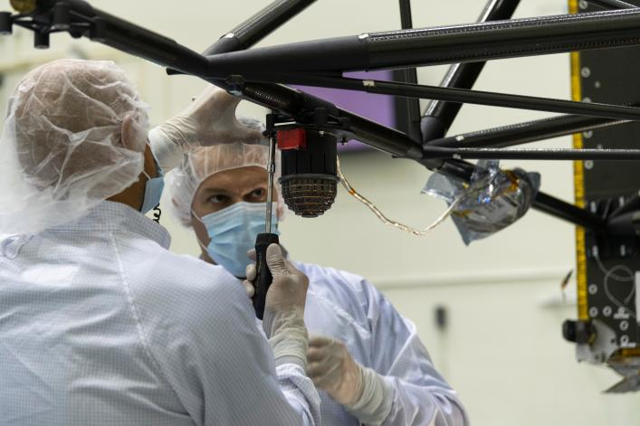
Magnetometers

Slide 28
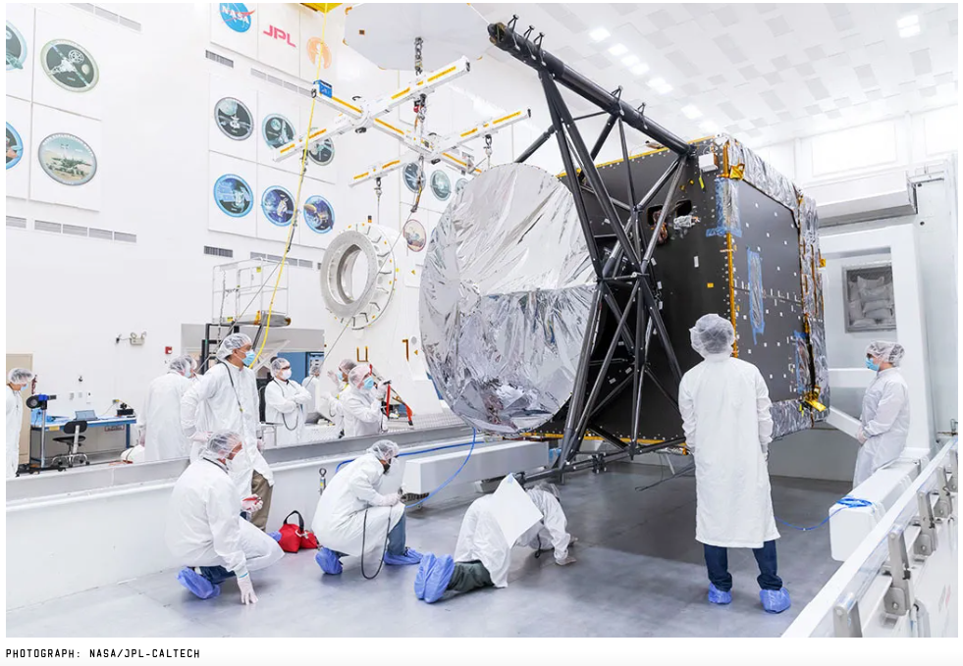
The Psyche Spacecraft at JPL

Slide 29
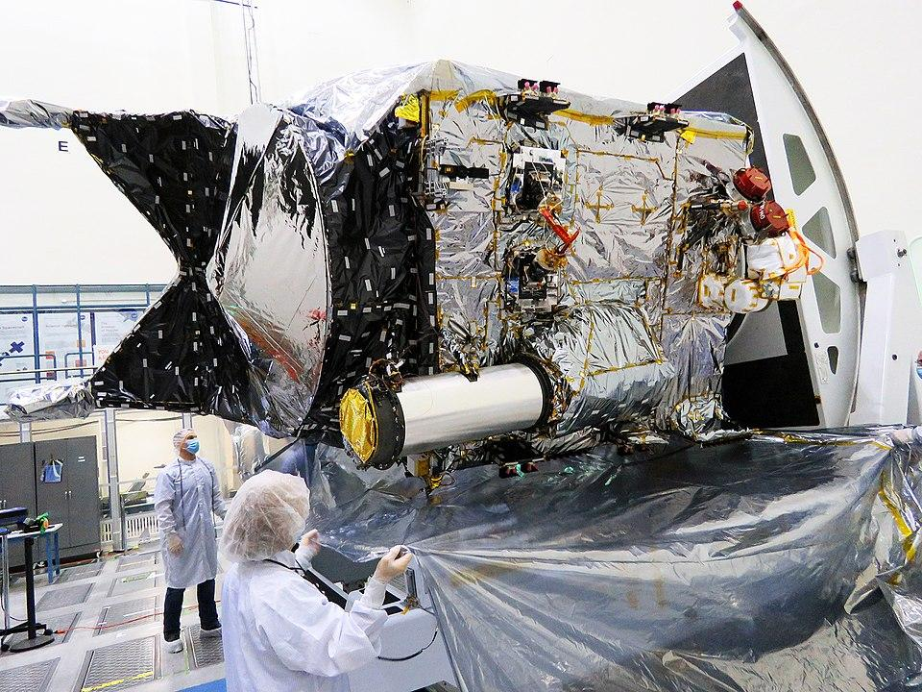
The Psyche Spacecraft at JPL

Slide 30
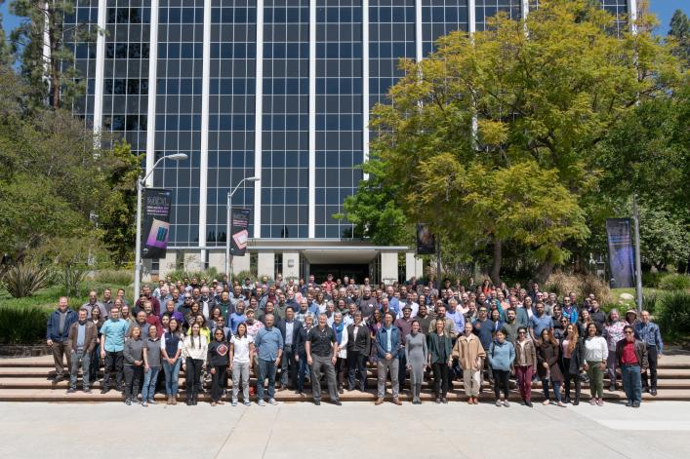
Part of the Psyche Team
Members of the Psyche team pose for a photo in front of the administration building of the Jet Propulsion Laboratory in Southern California on April 13, 2022, a few weeks before the spacecraft shipped from JPL to the agency's Kennedy Space Center in Florida.

Slide 31

Psyche Arrives in Florida
This is the C-17 aircraft that flew from March AFB, San Bernardino, CA to Titusville, Florida in 2022 containing the Psyche spacecraft.

Slide 32
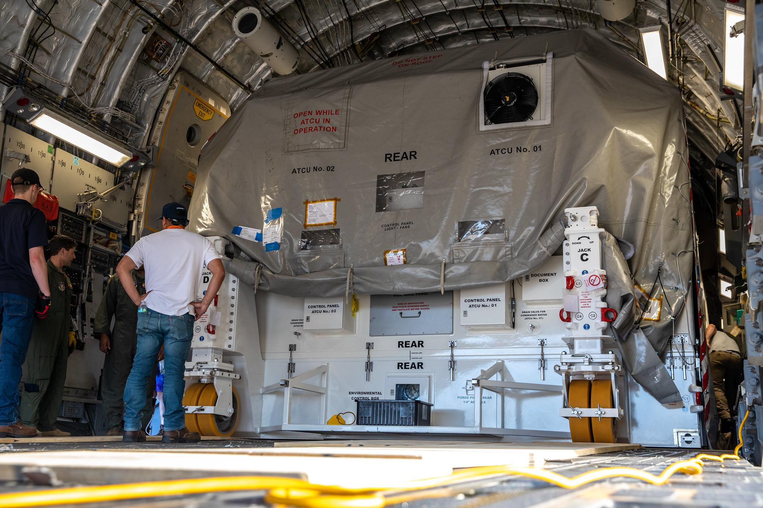
Now how do we get this out?
Psyche spacecraft is inside its own environmental enclosure.

Slide 33
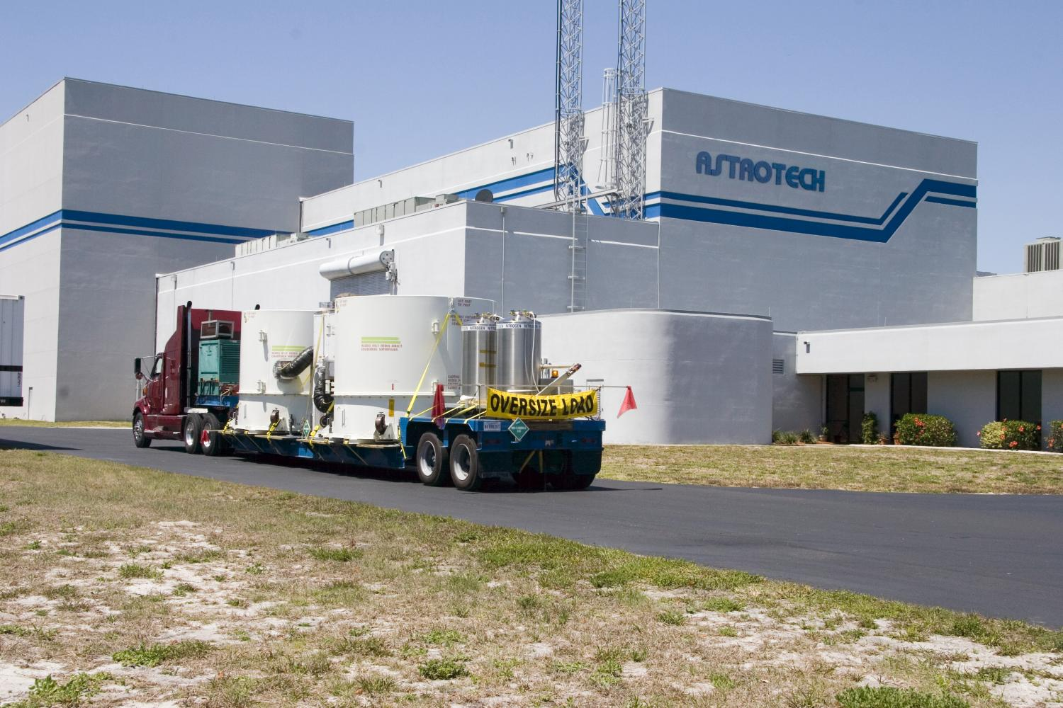
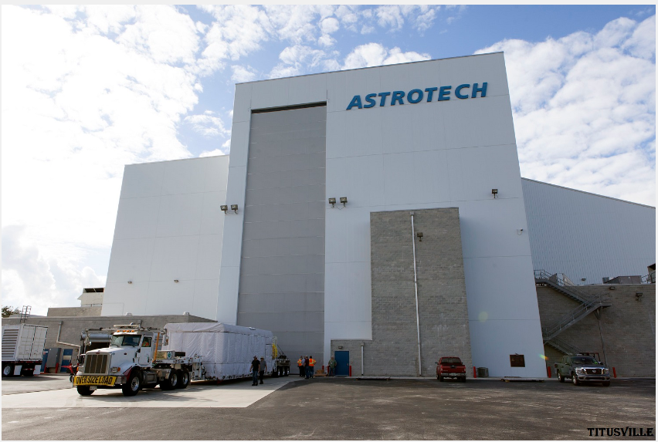
Astrotech Florida

Slide 34
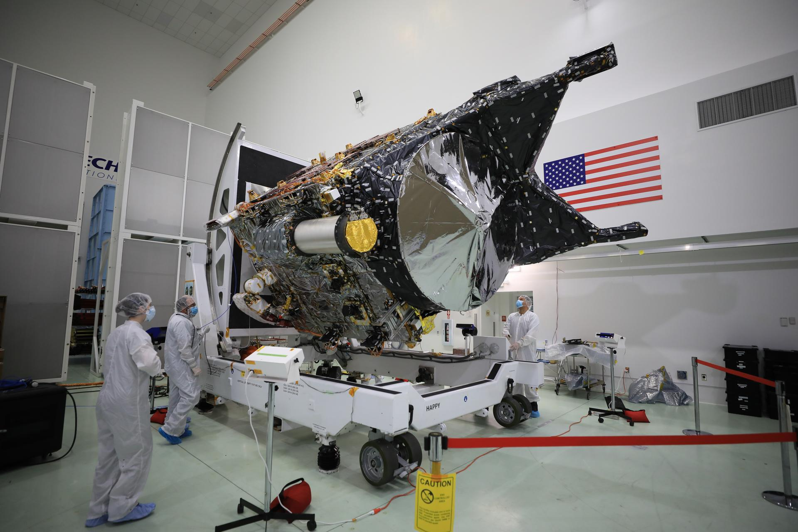
The Psyche Spacecraft at Astrotech

Slide 35
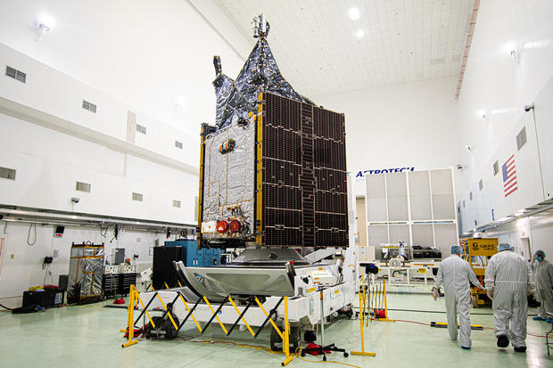
The Psyche Spacecraft at Astrotech

Slide 36
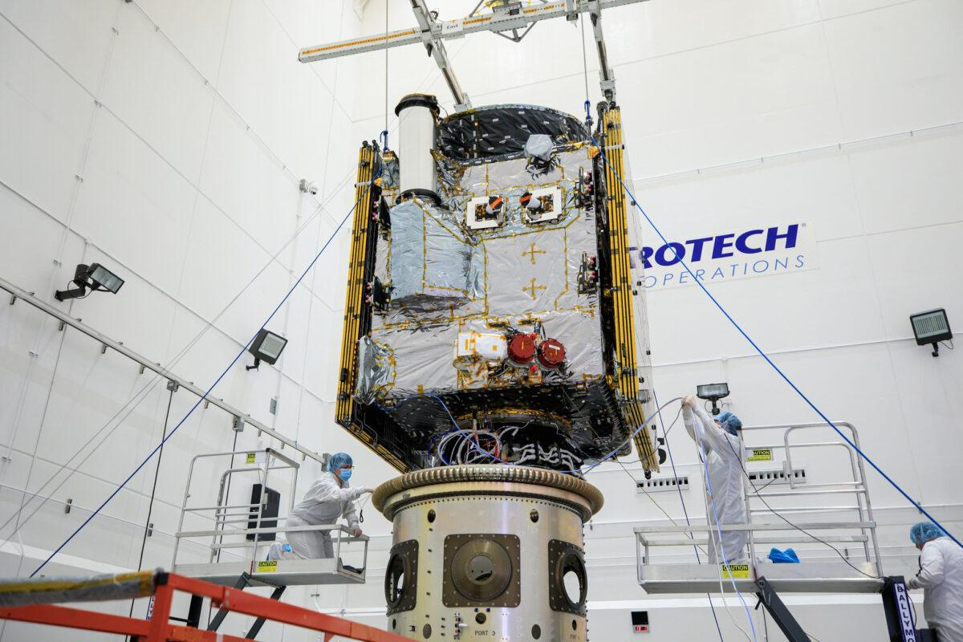
The Psyche Spacecraft at Astrotech

Slide 37
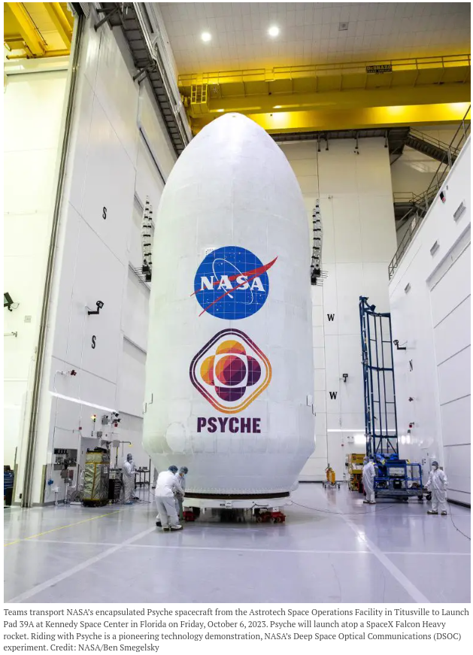
The Psyche Spacecraft in Shroud October 6

Slide 38

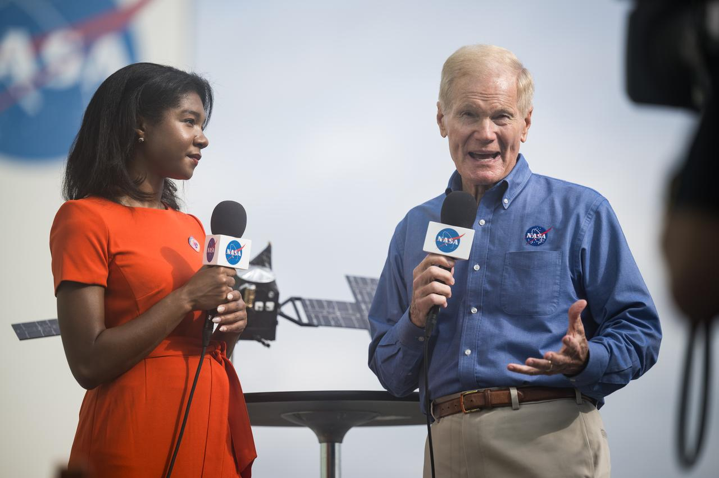
Pre-launch Interviews
NASA Administrator Bill Nelson interviewed by NASA public affairs specialist Jasmine Hopkins pre-launch on October 13, 2023

Slide 39
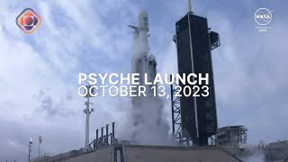
The Launch of Psyche

Slide 40
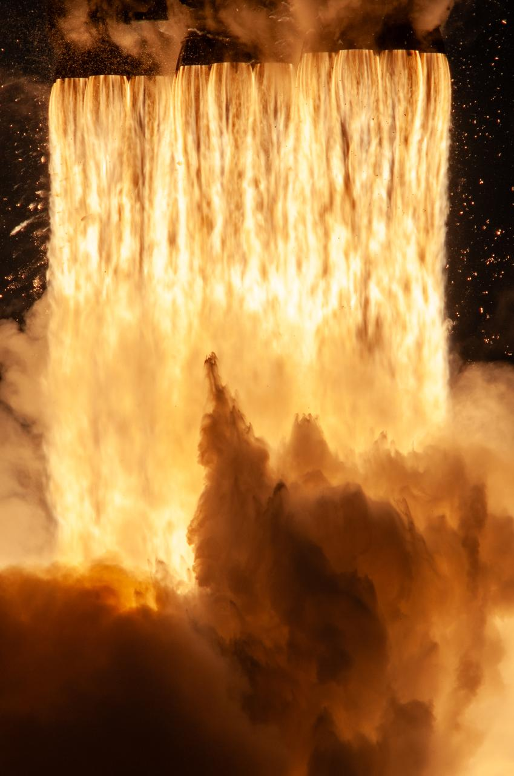
The Psyche Launch
The Falcon Heavy Rocket consists of three boosters each with 9 Merlin rocket engines. That is 27 total rocket engines burning liquid oxygen and rocket-grade kerosene (RP-1) propellant. Falcon Heavy generates more than 5 million pounds of thrust at liftoff.
For details go here:
https://www.spacex.com/vehicles/falcon-heavy/

Slide 41
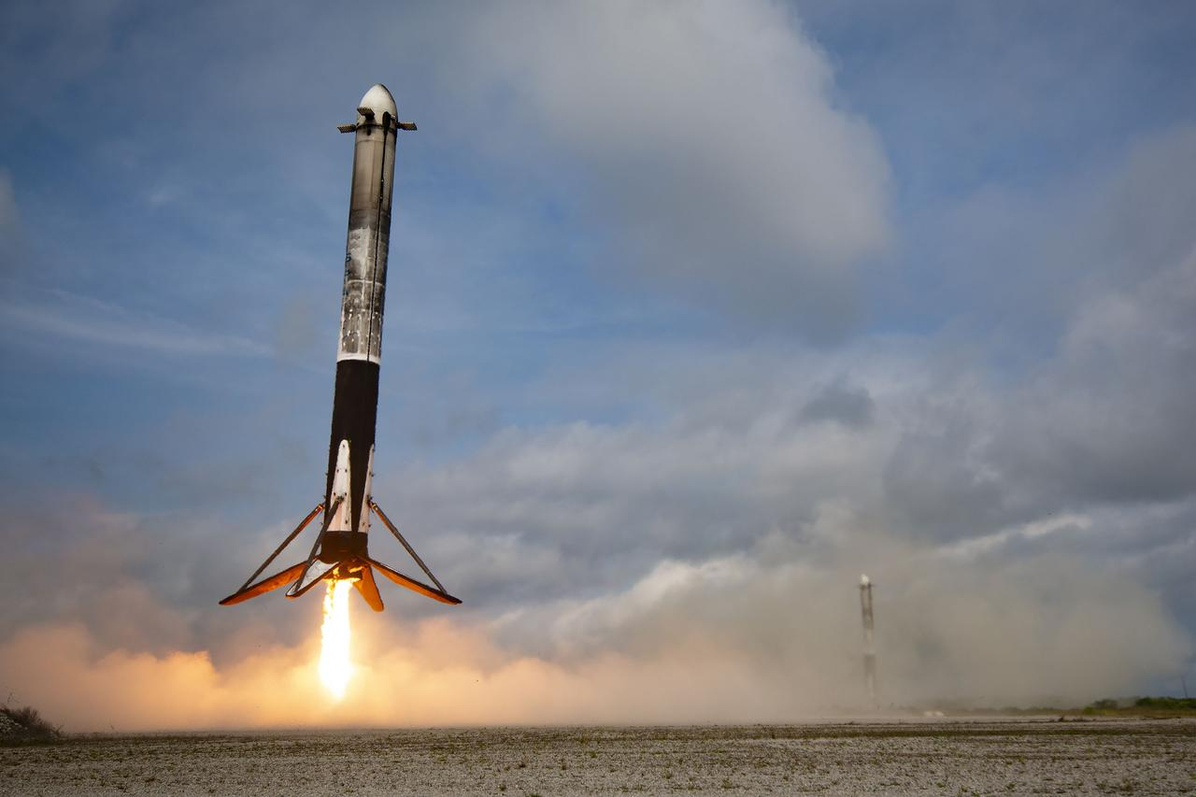
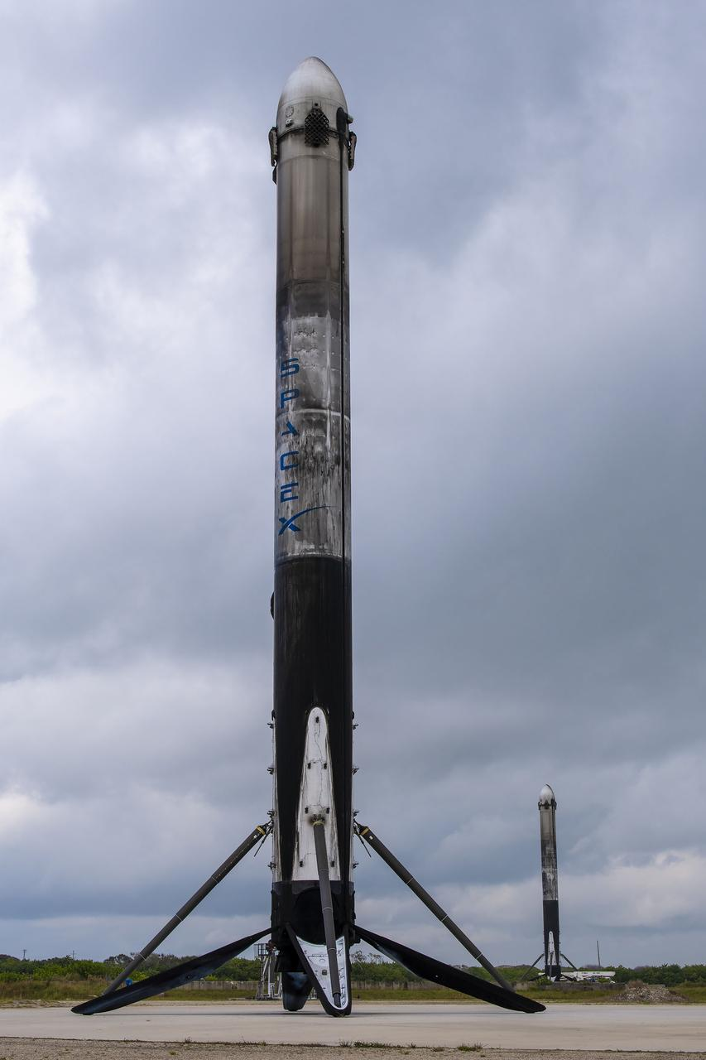
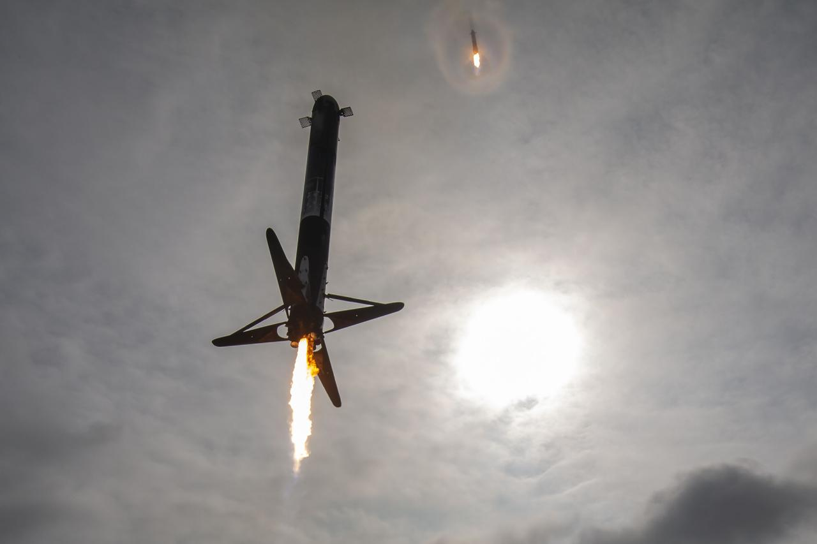
The Falcon Heavy Side Boosters Return

Slide 42
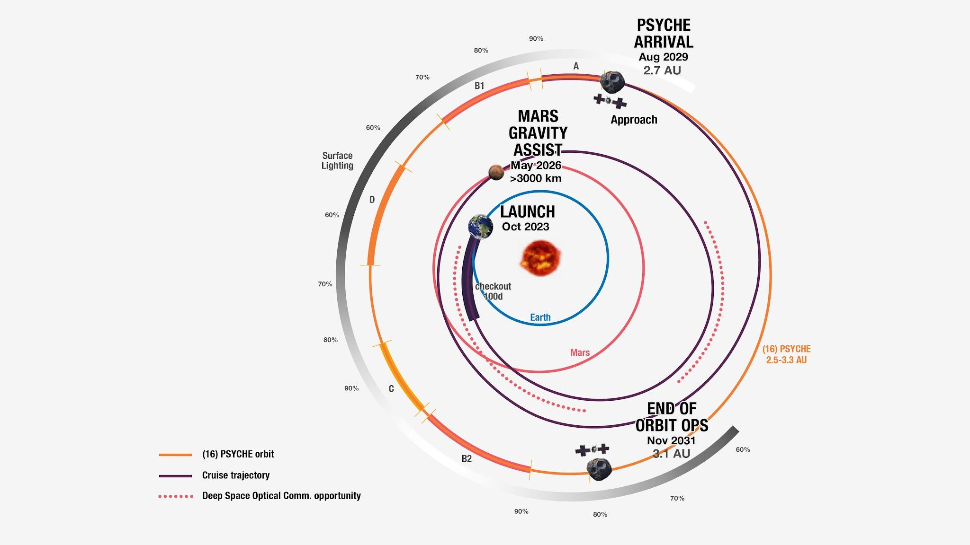
The Course to the Asteroid

Slide 43
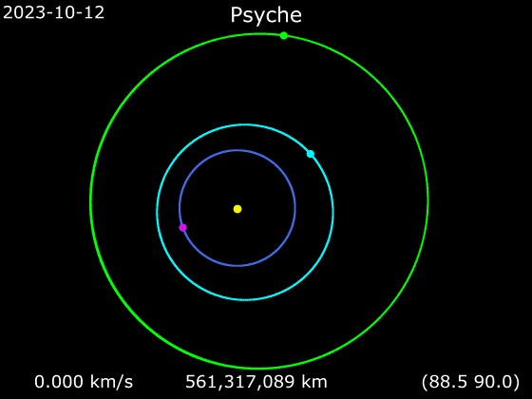
The Course to the Asteroid (Date-Velocity-Distance)

Slide 44
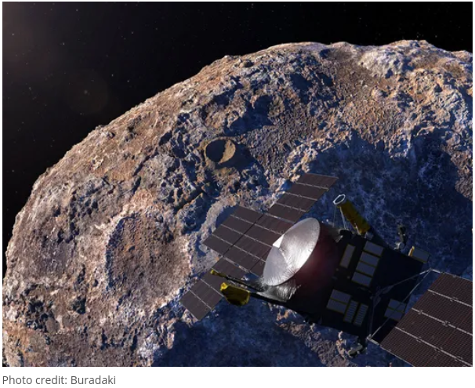
Psyche in Orbit

Slide 45
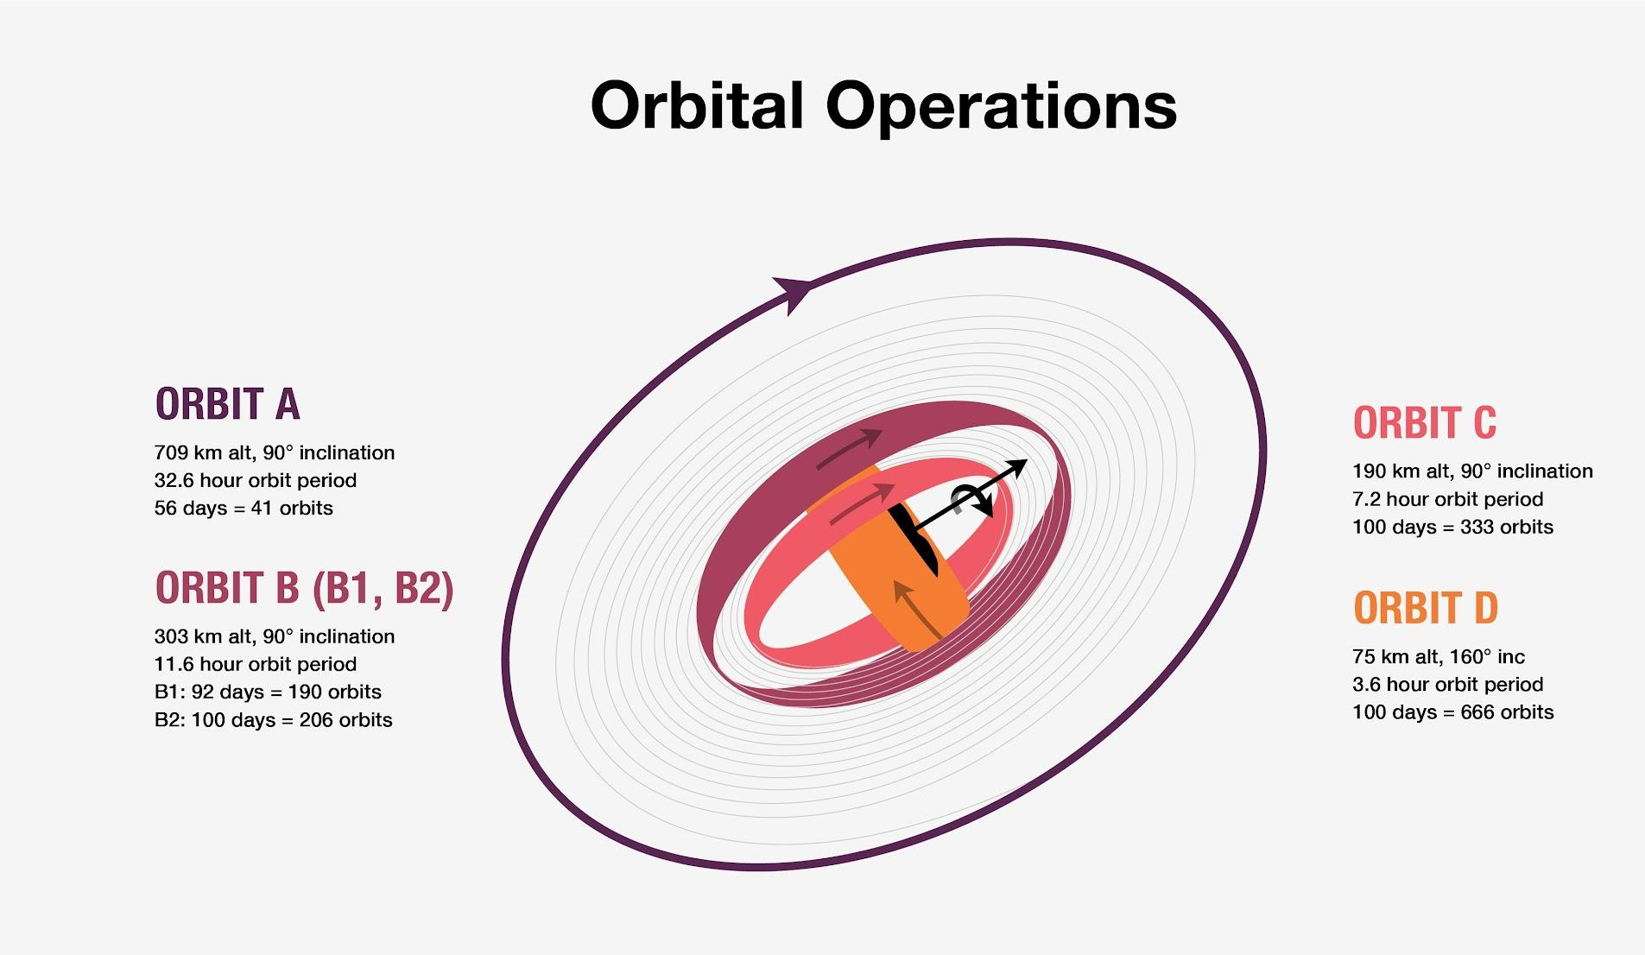
What Happens After It Gets There?
NASA's Psyche spacecraft will gather science at the asteroid Psyche at four orbit altitudes, as depicted in this graphic for 26 months. The orbits are named alphabetically from highest (A) to lowest (D), but they don't proceed in alphabetical order. Rather, they proceed based on the changing amount of sunlight illuminating the asteroid's surface during observation and the kind of science that can be done. Because sunlight will illuminate less and less of the asteroid's surface when the first part of Orbit B begins, this orbit is split into two parts, B1 and B2, so that the spacecraft can complete its mapping of the asteroid. The expected order of orbits during Psyche's prime mission is A, B1, D, C, B2.

Slide 46
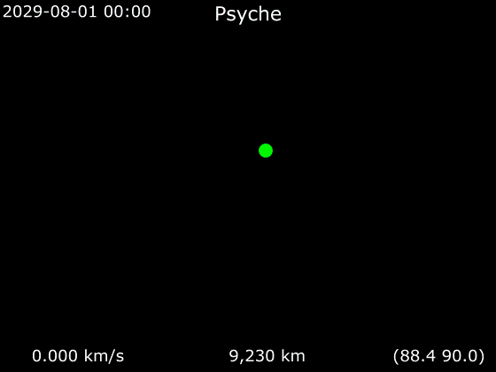
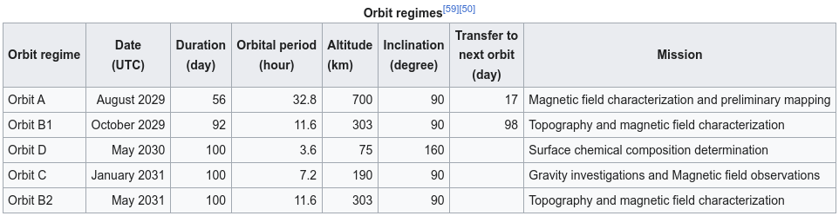
Orbits After Arrival to Psyche

Slide 47
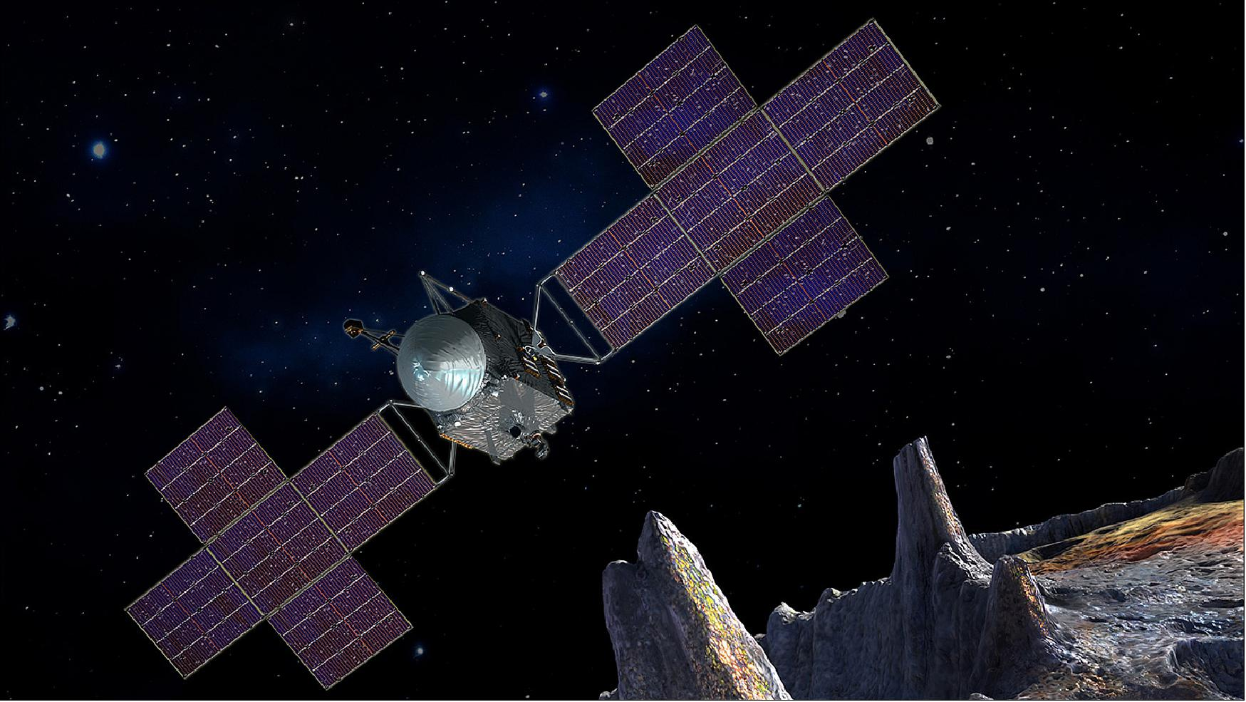
Bon Voyage Psyche!

Slide 48
How to Follow Your Psyche
NASA’s Eyes on the Solar System, a free web-based visualization tool, will track the location of the spacecraft in real time 3D. Visit go.nasa.gov/45k0OVY to see where Psyche is in the solar system.
About two months after launch, as the team performs an initial checkout of the spacecraft and science instruments, the mission expects to get the first images back from its multispectral imager. Once the team confirms the imager is functioning as expected, a webpage will feature the unprocessed, or raw, images flowing straight from the spacecraft to Earth. The first images will just be fields of stars, but you’ll be able to follow the spacecraft’s journey with Psyche’s own “eyes” as it heads toward its asteroid target and orbits this intriguing metal-rich world.
For more information about the NASA Psyche mission, go to:
http://www.nasa.gov/psyche or https://psyche.asu.edu/
NASA and ASU will also post regular social media updates on Facebook, Instagram, and X.

Slide 49
NASA: What Are They Doing?

